Slide 1

Objectives
In this session, you will learn to:
  Define and implement trading account
  Define and implement profit & loss account
  Use information systems for financial accounting
Notes:
Use this slide to explain the objective of the session to the students.

Slide 2
Introduction to Trading Account
Trading account:
  Is created to calculate the gross profit or gross loss incurred by the business.
  Is used to provide the following information:
    Gross profit or loss
    Summary of the financial performance of the business
    Data source to calculate the ratios that reflect the performance of the business
Notes:
Present the following situation of a business with diversification plans.
Situation: Global Systems is a chain of readymade garments retail stores. The Trial Balance for the current year is created. The company wants to diversify its operations and wants to start manufacturing the garments as well. With the present accounting records the company is not able to take a sound decision.
What is the profit or loss for the current year?
What are the assets and liabilities of the company?
Is the company in a position to take a loan from a bank?
Highlight the need for financial statements as a feeder6 to the information system to indicate the financial position and to create organization strategies. Establish the need for creating Trading account.
Discuss what type of businesses prepares Trading account.
Introduce the various components of Trading account.
Explain direct and indirect expenses.
Divide the class into groups and ask them to present direct and indirect expenses from the information given below:
Opening stock –2300
Purchases-2900
Sales returns-50
Sales-2540
Purchase returns-240
Closing stock-4770
Carriage inwards-10
Rent of office-5800
Carriage Inwards-500
Carriage outwards-250
Collate the answers given by the students and discuss the solution.

Slide 3
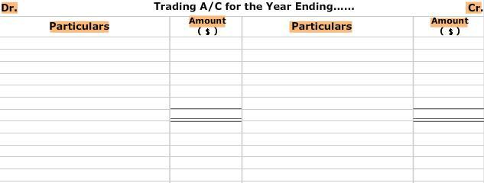
Introduction to Trading Account (Contd.)
The trading account is divided into two sides, the debit side (left) and the credit side (right), as shown in the following figure.
Notes:
Present the following situation of a business with diversification plans.
Situation: Global Systems is a chain of readymade garments retail stores. The Trial Balance for the current year is created. The company wants to diversify its operations and wants to start manufacturing the garments as well. With the present accounting records the company is not able to take a sound decision.
What is the profit or loss for the current year?
What are the assets and liabilities of the company?
Is the company in a position to take a loan from a bank?
Highlight the need for financial statements as a feeder6 to the information system to indicate the financial position and to create organization strategies. Establish the need for creating Trading account.
Discuss what type of businesses prepares Trading account.
Introduce the various components of Trading account.
Explain direct and indirect expenses.
Divide the class into groups and ask them to present direct and indirect expenses from the information given below:
Opening stock –2300
Purchases-2900
Sales returns-50
Sales-2540
Purchase returns-240
Closing stock-4770
Carriage inwards-10
Rent of office-5800
Carriage Inwards-500
Carriage outwards-250
Collate the answers given by the students and discuss the solution.

Slide 4
Creating the Trading Account
Rule for preparing the trading account:
  Copy all the entries of direct expenses and purchases from the debit side of the trial balance to the debit side of the trading account.
  Copy all the entries of sales from the credit side of the trial balance to the credit side of the trading account.

Slide 5
Creating the Trading Account (Contd.)
The debit side of the trading account includes the following components:
  Opening stock
  Direct expenses
  Purchases
  Purchase return

Slide 6
Creating the Trading Account (Contd.)
The credit side of the trading account includes the following components:
  Closing stock
  Sales
  Sales return

Slide 7

Creating the Trading Account (Contd.)
Now, let’s discuss about these components of trading account.

Slide 8
Creating the Trading Account (Contd.)
  Opening stock:
    Is the unsold stock of the previous accounting year or accounting period.
  Closing stock:
    Is the stock lying unsold at the end of the accounting year.
  Direct expenses:
    Are the expenses incurred on converting the goods to a saleable state.

Slide 9
Creating the Trading Account (Contd.)
  Purchases:
    Refer to the gross purchases made by the organization for producing its product.
  Purchase return:
    Refers to the goods that are returned to the supplier.
  Sales:
    Refers to the gross sales made.
  Sales return:
    Refers to the return of defected goods.

Slide 10
Creating the Trading Account (Contd.)
  Gross profit/loss:
    If the credit total is greater than the debit total, there is gross profit.
    If debit total is greater than the credit total, there is gross loss.
    To calculate the gross profit, the following equation is used:
    Gross profit = net sales – cost of goods sold

Slide 11
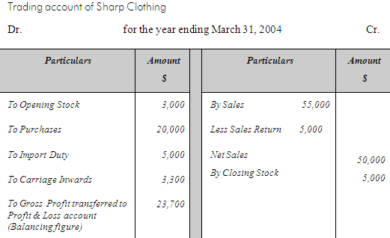
Creating the Trading Account (Contd.)
For example:
  The Sharp Clothing company prepares the trading account for the year ending March 31, 2004, as shown in the following figure.

Slide 12

Defining and Implementing a Profit and Loss Account
Why do we need to create Profit & Loss account?
Notes:
Use the slide and the next slide to initiate a classroom discussion by introducing business processes and the need to be familiar with them in any business organization.
Organizational Setup
Based on Profit
All organizations work for commercial gain. Examples of organizations that are based on profit include:
NIIT, Wipro, and Ranbaxy.
However, some organizations may not have commercial gains as the key focus area. Examples include:
Red Cross and World Health Organization (WHO). Red Cross collects money in the form of charity and donations, and then utilizes these funds for providing social services to the people.
Based on System Type
A system is a group of interdependent components that perform their respective functions to achieve the end objective or goal of the organization.
An organization’s system type should be steadied in isolation. The same system could be considered open or closed depending on the perspective and the factors one is considering for discussion.
Cite the following examples while discussing the classification of organizations based on system types:
Simple/Complex:
Consultancy firms in the corporate world have a limited number of processes, but these are well defined.
Architects on the other hand do not have any well-defined processes.
Adaptive/Non Adaptive:
The size, complexity and functions that an organization carries to meet its objectives define the type of system it adopts or adapts. The food industry is very adaptive as compared to the automobile industry. The automobile industry needs to take many more factors into account before deciding on a change.
Usually bigger companies take a longer time to adapt as compared to the smaller ones.
In traditional systems performance, measurement parameters and scope are missing, for example the government-run departments. Traditional systems are driven by a 'boss', but contemporary systems are driven by a 'leader'.
Based on Ownership
A Corporation is organized and governed by articles of law. Examples of some laws: Companies Act, 1956, Competition Act, 2002, etc.
Sole proprietorship:
Advantages: Sole proprietorship is simple and flexible. The business set up can be established, bought, sold, modified or closed in a short time span. No organizational level charters or bylaws are required for this type of business venture. Other than the normal permits or licenses required for any business activity, no public notifications or legal issues are required for starting, terminating, redirecting, or modifying the business. A single family (proprietor) can own the business so the size or the complexity of the business can change if the proprietor has the finances available.
Limitations: The proprietor and family own the risk both personally and professionally unless assets (the property or funds owned by an individual or organization) are safeguarded, by creating a trust or treating them as separate entities. There may not be enough resources to support the business and hence limited capacity to respond to business opportunities. The business might end with the demise of the proprietor so the next generation must purchase or inherit the business assets by paying the applicable taxes and costs. Merging of household and business finances makes it difficult to measure the performance of the business in terms of profitability and performance. Conflicts in the family, if the family is involved in the business, can paralyze the business processes and functions leading to loss of revenue.

Slide 13
Defining and Implementing a Profit and Loss Account (Contd.)
Since the trading account is not able to determine the net profit earned by the organization, the accounts department of the organization prepares the profit and loss account.
Notes:
Use the slide and the next slide to initiate a classroom discussion by introducing business processes and the need to be familiar with them in any business organization.
Organizational Setup
Based on Profit
All organizations work for commercial gain. Examples of organizations that are based on profit include:
NIIT, Wipro, and Ranbaxy.
However, some organizations may not have commercial gains as the key focus area. Examples include:
Red Cross and World Health Organization (WHO). Red Cross collects money in the form of charity and donations, and then utilizes these funds for providing social services to the people.
Based on System Type
A system is a group of interdependent components that perform their respective functions to achieve the end objective or goal of the organization.
An organization’s system type should be steadied in isolation. The same system could be considered open or closed depending on the perspective and the factors one is considering for discussion.
Cite the following examples while discussing the classification of organizations based on system types:
Simple/Complex:
Consultancy firms in the corporate world have a limited number of processes, but these are well defined.
Architects on the other hand do not have any well-defined processes.
Adaptive/Non Adaptive:
The size, complexity and functions that an organization carries to meet its objectives define the type of system it adopts or adapts. The food industry is very adaptive as compared to the automobile industry. The automobile industry needs to take many more factors into account before deciding on a change.
Usually bigger companies take a longer time to adapt as compared to the smaller ones.
In traditional systems performance, measurement parameters and scope are missing, for example the government-run departments. Traditional systems are driven by a 'boss', but contemporary systems are driven by a 'leader'.
Based on Ownership
A Corporation is organized and governed by articles of law. Examples of some laws: Companies Act, 1956, Competition Act, 2002, etc.
Sole proprietorship:
Advantages: Sole proprietorship is simple and flexible. The business set up can be established, bought, sold, modified or closed in a short time span. No organizational level charters or bylaws are required for this type of business venture. Other than the normal permits or licenses required for any business activity, no public notifications or legal issues are required for starting, terminating, redirecting, or modifying the business. A single family (proprietor) can own the business so the size or the complexity of the business can change if the proprietor has the finances available.
Limitations: The proprietor and family own the risk both personally and professionally unless assets (the property or funds owned by an individual or organization) are safeguarded, by creating a trust or treating them as separate entities. There may not be enough resources to support the business and hence limited capacity to respond to business opportunities. The business might end with the demise of the proprietor so the next generation must purchase or inherit the business assets by paying the applicable taxes and costs. Merging of household and business finances makes it difficult to measure the performance of the business in terms of profitability and performance. Conflicts in the family, if the family is involved in the business, can paralyze the business processes and functions leading to loss of revenue.

Slide 14
Introduction to Profit & Loss Account
A Profit & Loss account is used to:
  Provide information of the net profit or loss.
  Enable comparison of current year’s profit with the previous year’s profit.
  Exercise control over expenses by comparing the expenses of the current year with those of the previous year.
Notes:
Initiate the session using the scenario of the previous OCR and build the need for creating Profit & Loss account.
Divide the class into groups of four to five students. Ask each group to give one instance of the following situations:
Gross profit and net loss
Gross profit and net profit
Gross loss and net profit
Gross loss and net loss
Collate the answers given by the students and discuss the components of Profit &Loss account
Relate the consistency convention to the ‘uses’ of Profit & Loss account. For enabling comparison of profits over the years, the practices and methods have to be consistent.
Demonstrate the steps to create Profit & Loss account and the format of Profit & Loss account.
Discuss the difference between expenditure of capital nature and revenue nature.

Slide 15
Introduction to Profit & Loss Account (Contd.)
The net profit can be calculated by deducting indirect expenses from the gross profit.
To calculate the net profit, use the following equation:
  Net profit/Net loss = Gross profit/Gross loss – Indirect expenses + Non-sales income.
This equation is known as the net profit equation.
Notes:
Initiate the session using the scenario of the previous OCR and build the need for creating Profit & Loss account.
Divide the class into groups of four to five students. Ask each group to give one instance of the following situations:
Gross profit and net loss
Gross profit and net profit
Gross loss and net profit
Gross loss and net loss
Collate the answers given by the students and discuss the components of Profit &Loss account
Relate the consistency convention to the ‘uses’ of Profit & Loss account. For enabling comparison of profits over the years, the practices and methods have to be consistent.
Demonstrate the steps to create Profit & Loss account and the format of Profit & Loss account.
Discuss the difference between expenditure of capital nature and revenue nature.

Slide 16
Components of Profit & Loss Account
  The components of Profit & Loss Account can be broadly divided into two heads:
    Indirect Expenses
    Non-sales Income
Notes:
Direct expenses: Direct expense is expense incurred on bringing the goods to factory/office and on converting the goods to saleable condition. Some examples are import duty and octroi duty. If the expense is given as Carriage or Freight only, it is taken as a direct expense. Typically, where the expenses relate to factory or plant etc. they are taken as direct expenses whereas if they relate to office then they are taken as indirect expenses.
Carriage outward is not a direct expense. Carriage outward is incurred on bringing the goods to the location from where they can be sold. Thus they are the selling expenses. Such expenses are called as Indirect expenses.

Slide 17
Components of Profit & Loss Account (Contd.)
Indirect expenses:
  Are debited to the Profit & Loss account.
  Are classified into the following types of expenses:
    Selling and distribution expenses
    Administration and office management expenses
    Financial expenses
Notes:
Direct expenses: Direct expense is expense incurred on bringing the goods to factory/office and on converting the goods to saleable condition. Some examples are import duty and octroi duty. If the expense is given as Carriage or Freight only, it is taken as a direct expense. Typically, where the expenses relate to factory or plant etc. they are taken as direct expenses whereas if they relate to office then they are taken as indirect expenses.
Carriage outward is not a direct expense. Carriage outward is incurred on bringing the goods to the location from where they can be sold. Thus they are the selling expenses. Such expenses are called as Indirect expenses.

Slide 18
Components of Profit & Loss Account (Contd.)
Non-sales Income:
  Is termed as ‘other income’ and is credited to the Profit & Loss account.
  For example:
    Interest on fixed deposits, discount received, and income from investment.
Notes:
Direct expenses: Direct expense is expense incurred on bringing the goods to factory/office and on converting the goods to saleable condition. Some examples are import duty and octroi duty. If the expense is given as Carriage or Freight only, it is taken as a direct expense. Typically, where the expenses relate to factory or plant etc. they are taken as direct expenses whereas if they relate to office then they are taken as indirect expenses.
Carriage outward is not a direct expense. Carriage outward is incurred on bringing the goods to the location from where they can be sold. Thus they are the selling expenses. Such expenses are called as Indirect expenses.

Slide 19
Components of Profit & Loss Account (Contd.)
Components of Profit & Loss account that cannot be grouped under the preceding heads are:
  Depreciation
  Deferred revenue expenditure

Slide 20
Components of Profit & Loss Account (Contd.)
  Depreciation:
    The loss or reduction in the value of a fixed asset due to wear and tear, obsolescence, is known as depreciation.
    For example, a car depreciates over time, due to wear and tear. The value of car come down with usage.

Slide 21
Components of Profit & Loss Account (Contd.)
  Deferred revenue expenditure:
    It is unusually heavy and its benefit is likely to be available for more than one year.
    For example, an organization may spend a huge amount on TV ads to introduce a new product, but its benefit may be available for more than one year.

Slide 22
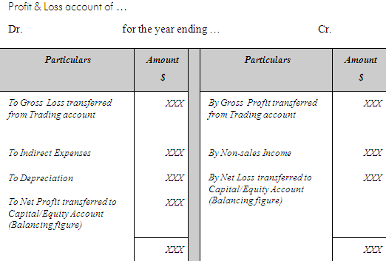
Components of Profit & Loss Account (Contd.)
  The components of Profit & Loss account are represented in the format, as shown in the following figure.

Slide 23
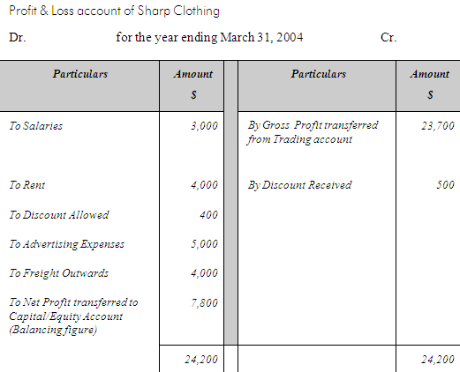
Components of Profit & Loss Account (Contd.)
  For example:
    The accountant of Sharp Clothing company prepares the
    Profit & Loss account, as shown in the following figure.

Slide 24
Using Information Systems for Financial Accounting
Let’s now discuss about automating the accounting system.
Notes:
Use the slide and the next slide to initiate a classroom discussion by introducing business processes and the need to be familiar with them in any business organization.
Organizational Setup
Based on Profit
All organizations work for commercial gain. Examples of organizations that are based on profit include:
NIIT, Wipro, and Ranbaxy.
However, some organizations may not have commercial gains as the key focus area. Examples include:
Red Cross and World Health Organization (WHO). Red Cross collects money in the form of charity and donations, and then utilizes these funds for providing social services to the people.
Based on System Type
A system is a group of interdependent components that perform their respective functions to achieve the end objective or goal of the organization.
An organization’s system type should be steadied in isolation. The same system could be considered open or closed depending on the perspective and the factors one is considering for discussion.
Cite the following examples while discussing the classification of organizations based on system types:
Simple/Complex:
Consultancy firms in the corporate world have a limited number of processes, but these are well defined.
Architects on the other hand do not have any well-defined processes.
Adaptive/Non Adaptive:
The size, complexity and functions that an organization carries to meet its objectives define the type of system it adopts or adapts. The food industry is very adaptive as compared to the automobile industry. The automobile industry needs to take many more factors into account before deciding on a change.
Usually bigger companies take a longer time to adapt as compared to the smaller ones.
In traditional systems performance, measurement parameters and scope are missing, for example the government-run departments. Traditional systems are driven by a 'boss', but contemporary systems are driven by a 'leader'.
Based on Ownership
A Corporation is organized and governed by articles of law. Examples of some laws: Companies Act, 1956, Competition Act, 2002, etc.
Sole proprietorship:
Advantages: Sole proprietorship is simple and flexible. The business set up can be established, bought, sold, modified or closed in a short time span. No organizational level charters or bylaws are required for this type of business venture. Other than the normal permits or licenses required for any business activity, no public notifications or legal issues are required for starting, terminating, redirecting, or modifying the business. A single family (proprietor) can own the business so the size or the complexity of the business can change if the proprietor has the finances available.
Limitations: The proprietor and family own the risk both personally and professionally unless assets (the property or funds owned by an individual or organization) are safeguarded, by creating a trust or treating them as separate entities. There may not be enough resources to support the business and hence limited capacity to respond to business opportunities. The business might end with the demise of the proprietor so the next generation must purchase or inherit the business assets by paying the applicable taxes and costs. Merging of household and business finances makes it difficult to measure the performance of the business in terms of profitability and performance. Conflicts in the family, if the family is involved in the business, can paralyze the business processes and functions leading to loss of revenue.

Slide 25

Using Information Systems for Financial Accounting (Contd.)
Why do we need to automate the accounting system?
Notes:
Use the slide and the next slide to initiate a classroom discussion by introducing business processes and the need to be familiar with them in any business organization.
Organizational Setup
Based on Profit
All organizations work for commercial gain. Examples of organizations that are based on profit include:
NIIT, Wipro, and Ranbaxy.
However, some organizations may not have commercial gains as the key focus area. Examples include:
Red Cross and World Health Organization (WHO). Red Cross collects money in the form of charity and donations, and then utilizes these funds for providing social services to the people.
Based on System Type
A system is a group of interdependent components that perform their respective functions to achieve the end objective or goal of the organization.
An organization’s system type should be steadied in isolation. The same system could be considered open or closed depending on the perspective and the factors one is considering for discussion.
Cite the following examples while discussing the classification of organizations based on system types:
Simple/Complex:
Consultancy firms in the corporate world have a limited number of processes, but these are well defined.
Architects on the other hand do not have any well-defined processes.
Adaptive/Non Adaptive:
The size, complexity and functions that an organization carries to meet its objectives define the type of system it adopts or adapts. The food industry is very adaptive as compared to the automobile industry. The automobile industry needs to take many more factors into account before deciding on a change.
Usually bigger companies take a longer time to adapt as compared to the smaller ones.
In traditional systems performance, measurement parameters and scope are missing, for example the government-run departments. Traditional systems are driven by a 'boss', but contemporary systems are driven by a 'leader'.
Based on Ownership
A Corporation is organized and governed by articles of law. Examples of some laws: Companies Act, 1956, Competition Act, 2002, etc.
Sole proprietorship:
Advantages: Sole proprietorship is simple and flexible. The business set up can be established, bought, sold, modified or closed in a short time span. No organizational level charters or bylaws are required for this type of business venture. Other than the normal permits or licenses required for any business activity, no public notifications or legal issues are required for starting, terminating, redirecting, or modifying the business. A single family (proprietor) can own the business so the size or the complexity of the business can change if the proprietor has the finances available.
Limitations: The proprietor and family own the risk both personally and professionally unless assets (the property or funds owned by an individual or organization) are safeguarded, by creating a trust or treating them as separate entities. There may not be enough resources to support the business and hence limited capacity to respond to business opportunities. The business might end with the demise of the proprietor so the next generation must purchase or inherit the business assets by paying the applicable taxes and costs. Merging of household and business finances makes it difficult to measure the performance of the business in terms of profitability and performance. Conflicts in the family, if the family is involved in the business, can paralyze the business processes and functions leading to loss of revenue.

Slide 26
Using Information Systems for Financial Accounting (Contd.)
Manually creating financial statements takes a lot of time and might have errors.
Notes:
Use the slide and the next slide to initiate a classroom discussion by introducing business processes and the need to be familiar with them in any business organization.
Organizational Setup
Based on Profit
All organizations work for commercial gain. Examples of organizations that are based on profit include:
NIIT, Wipro, and Ranbaxy.
However, some organizations may not have commercial gains as the key focus area. Examples include:
Red Cross and World Health Organization (WHO). Red Cross collects money in the form of charity and donations, and then utilizes these funds for providing social services to the people.
Based on System Type
A system is a group of interdependent components that perform their respective functions to achieve the end objective or goal of the organization.
An organization’s system type should be steadied in isolation. The same system could be considered open or closed depending on the perspective and the factors one is considering for discussion.
Cite the following examples while discussing the classification of organizations based on system types:
Simple/Complex:
Consultancy firms in the corporate world have a limited number of processes, but these are well defined.
Architects on the other hand do not have any well-defined processes.
Adaptive/Non Adaptive:
The size, complexity and functions that an organization carries to meet its objectives define the type of system it adopts or adapts. The food industry is very adaptive as compared to the automobile industry. The automobile industry needs to take many more factors into account before deciding on a change.
Usually bigger companies take a longer time to adapt as compared to the smaller ones.
In traditional systems performance, measurement parameters and scope are missing, for example the government-run departments. Traditional systems are driven by a 'boss', but contemporary systems are driven by a 'leader'.
Based on Ownership
A Corporation is organized and governed by articles of law. Examples of some laws: Companies Act, 1956, Competition Act, 2002, etc.
Sole proprietorship:
Advantages: Sole proprietorship is simple and flexible. The business set up can be established, bought, sold, modified or closed in a short time span. No organizational level charters or bylaws are required for this type of business venture. Other than the normal permits or licenses required for any business activity, no public notifications or legal issues are required for starting, terminating, redirecting, or modifying the business. A single family (proprietor) can own the business so the size or the complexity of the business can change if the proprietor has the finances available.
Limitations: The proprietor and family own the risk both personally and professionally unless assets (the property or funds owned by an individual or organization) are safeguarded, by creating a trust or treating them as separate entities. There may not be enough resources to support the business and hence limited capacity to respond to business opportunities. The business might end with the demise of the proprietor so the next generation must purchase or inherit the business assets by paying the applicable taxes and costs. Merging of household and business finances makes it difficult to measure the performance of the business in terms of profitability and performance. Conflicts in the family, if the family is involved in the business, can paralyze the business processes and functions leading to loss of revenue.

Slide 27
Using Information Systems for Financial Accounting (Contd.)
Therefore, organizations use Accounting Information System (AIS) to automate the accounting process.
Notes:
Use the slide and the next slide to initiate a classroom discussion by introducing business processes and the need to be familiar with them in any business organization.
Organizational Setup
Based on Profit
All organizations work for commercial gain. Examples of organizations that are based on profit include:
NIIT, Wipro, and Ranbaxy.
However, some organizations may not have commercial gains as the key focus area. Examples include:
Red Cross and World Health Organization (WHO). Red Cross collects money in the form of charity and donations, and then utilizes these funds for providing social services to the people.
Based on System Type
A system is a group of interdependent components that perform their respective functions to achieve the end objective or goal of the organization.
An organization’s system type should be steadied in isolation. The same system could be considered open or closed depending on the perspective and the factors one is considering for discussion.
Cite the following examples while discussing the classification of organizations based on system types:
Simple/Complex:
Consultancy firms in the corporate world have a limited number of processes, but these are well defined.
Architects on the other hand do not have any well-defined processes.
Adaptive/Non Adaptive:
The size, complexity and functions that an organization carries to meet its objectives define the type of system it adopts or adapts. The food industry is very adaptive as compared to the automobile industry. The automobile industry needs to take many more factors into account before deciding on a change.
Usually bigger companies take a longer time to adapt as compared to the smaller ones.
In traditional systems performance, measurement parameters and scope are missing, for example the government-run departments. Traditional systems are driven by a 'boss', but contemporary systems are driven by a 'leader'.
Based on Ownership
A Corporation is organized and governed by articles of law. Examples of some laws: Companies Act, 1956, Competition Act, 2002, etc.
Sole proprietorship:
Advantages: Sole proprietorship is simple and flexible. The business set up can be established, bought, sold, modified or closed in a short time span. No organizational level charters or bylaws are required for this type of business venture. Other than the normal permits or licenses required for any business activity, no public notifications or legal issues are required for starting, terminating, redirecting, or modifying the business. A single family (proprietor) can own the business so the size or the complexity of the business can change if the proprietor has the finances available.
Limitations: The proprietor and family own the risk both personally and professionally unless assets (the property or funds owned by an individual or organization) are safeguarded, by creating a trust or treating them as separate entities. There may not be enough resources to support the business and hence limited capacity to respond to business opportunities. The business might end with the demise of the proprietor so the next generation must purchase or inherit the business assets by paying the applicable taxes and costs. Merging of household and business finances makes it difficult to measure the performance of the business in terms of profitability and performance. Conflicts in the family, if the family is involved in the business, can paralyze the business processes and functions leading to loss of revenue.

Slide 28
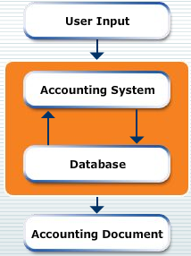
Accounting Information System
  It is a type of a data processing system that collects data from various sources, processes that data, and generates information to perform tasks.
  The following figure depicts the working of AIS.
Notes:
Use this and the following slides to explain AIS and its benefits.

Slide 29
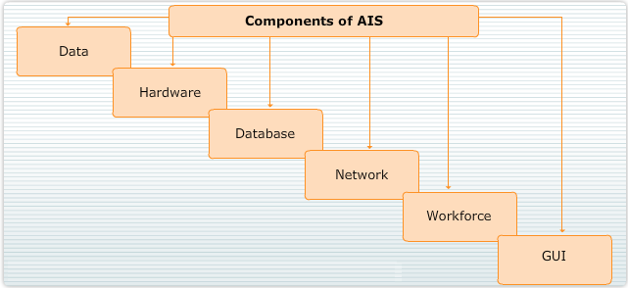
Accounting Information System (Contd.)
The components of AIS are shown in the following figure.
Notes:
Use this and the following slides to explain AIS and its benefits.

Slide 30
Accounting Information System (Contd.)
Benefits of AIS:
  Provides efficiency and reliability
  Ensures accurate reporting
  Generates error-free financial statements

Slide 31
Accounting Information System (Contd.)
The most commonly used AISs are:
  Tally
  Microsoft Dynamic Navision

Slide 32
Summary
In this session, you learned that:
  The financial statement helps to measure the performance of the business by calculating the profit earned and loss incurred by the business.
  The trading account is created to calculate the gross profit or gross loss incurred by the business.
  A trading account is used to:
    Provide information about gross profit or gross loss.
    Provide a summary of the financial performance of the business.
    Provide a data source to calculate the ratios that reflect the performance of the business.
  The result shown by the trading account is not sufficient to determine the net profit earned by the organization. Therefore, the accounts department of the organization prepares the profit and loss account.
Notes:
Use this and the following slides to summarize the key points of the session to the students.

Slide 33
Summary (Contd.)
  A Profit & Loss account is used to:
    Provide information of the net profit or loss.
    Enable comparison of current year’s profit with the previous year’s profit.
    Exercise control over expenses by comparing the expenses of the current year with those of the previous year.
  AIS is an automated way to implement the accounting process.
  The components of an AIS include data, hardware, software, network, workforce, and the Graphical User Interface (GUI).
  An AIS provides the following benefits:
    Efficiency and reliability
    Accurate reporting
    Error-free financial statements
Notes:
Use this and the following slides to summarize the key points of the session to the students.

